Slide 1
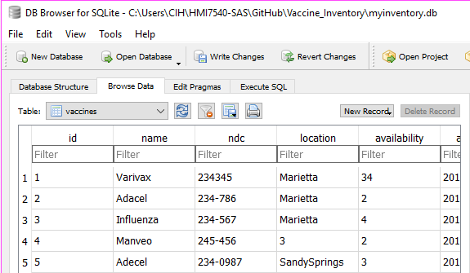
Vinventory
-Real time vaccine Inventory system for a Clinic.
-Contributors
Bushra Siddiqi
Sadia Ghani

